Slide 1
  Compass:
  Clergy Information

Slide 2
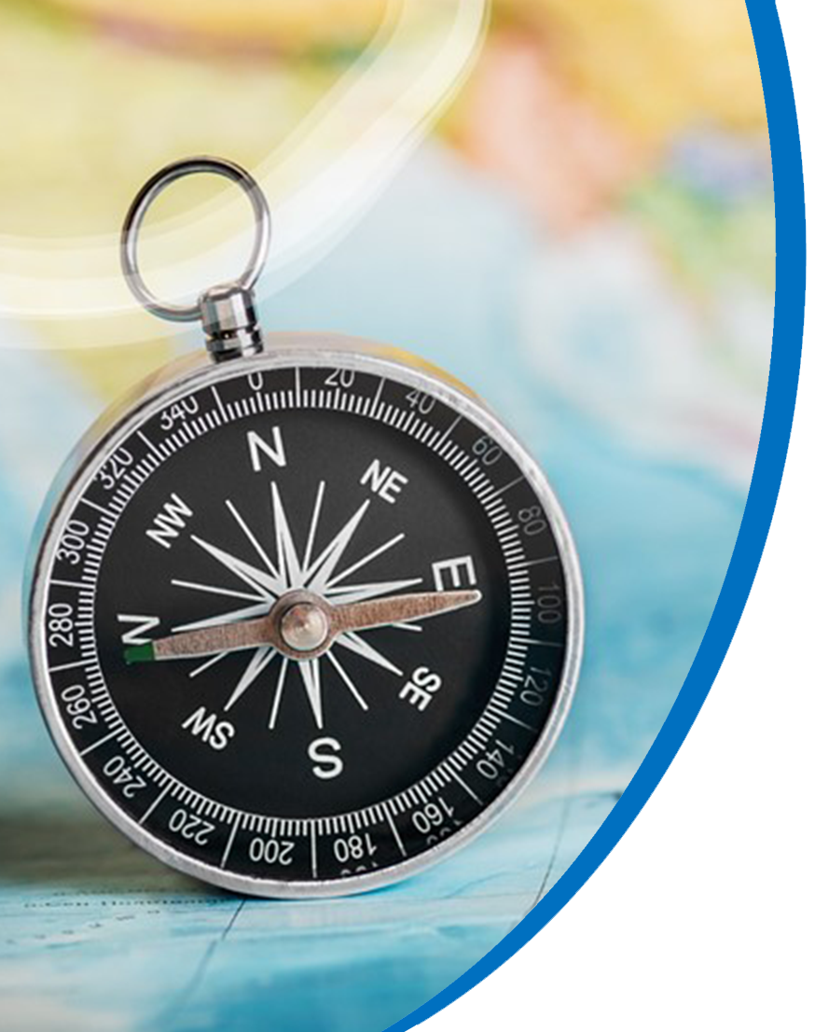
What to Know
Active clergy—keep benefits
earned previously under legacy plans (Pre-82, MPP, CRSP)
Retired clergy—no impact,
no changes
Eligibility—75% and 100%
Notes:
CRSP is not ending. It’s changing. NO longer will provide non-match, and match, or accrued DB service.
Compass will have no adverse impact on other plans.
Q: when will CRSP DC transfer into Compass, if I commence CRSP DB on July 1, 2025 or earlier?
Q: when will UMPIP transfer into Compass?
Q: will the 35% of MPP transfer to Compass upon annuitizing the 65% for a July 1, 2026 retirement?
Q: when will UMPIP transfer into Compass?
Q: will I have the same investment control of MPP35, UMPIP, and CRSP DC balances transferred into Compass?

Slide 3
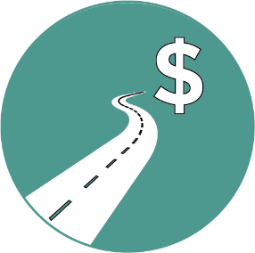


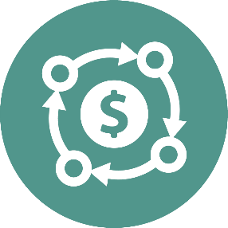
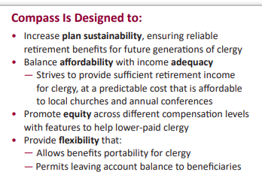
Why Compass?
Sustainability
Affordability
Adequacy
Flexibility

Slide 4





UMC Retirement Contributions
(effective January 1, 2026)
Automatic contributions
In partnership with clergy
$1/$1 matching
contribution
(up to 4% of compensation)
$150* per month
+
3% of compensation**
+
* 2026 amount; increases 2% per year ($5 increments)/prorated by appointment percentage (will not go up until 2028)
** Compensation includes 35% parsonage value ($10,000 minimum floor) or housing allowance

Slide 5


Compensation Highlights
Parsonage
35% of Annual Base Wages
Minimum of $10,000
    Not prorated if less than full time appointment
    A parsonage will be applicable across ALL churches in the appointment
    The parsonage value is just for the purpose of retirement plan contributions, NOT taxes (real rental value is used for tax purposes)
    Excludes
    Severance Pay
One time or occasional payments (i.e., bonus or expense reimbursements)

Slide 6
Billing to local churches:
The CBOPHB has voted to bill all churches with eligible clergy for Compass (unless waived) at 10.5% of pension-based compensation regardless of personal contribution amounts. (This is 3.3% less than current CRSP billings of 13.8%)
***UNY is the plan sponsor for Compass personal contributions starting 1/1/2026
Why??:
1. Simplicity
2. Arrearages
3. Retro matching contributions

Slide 8
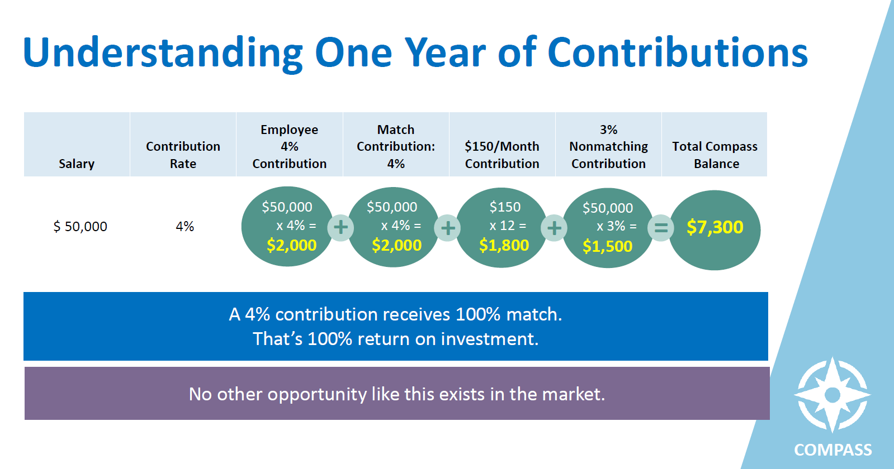

Slide 9
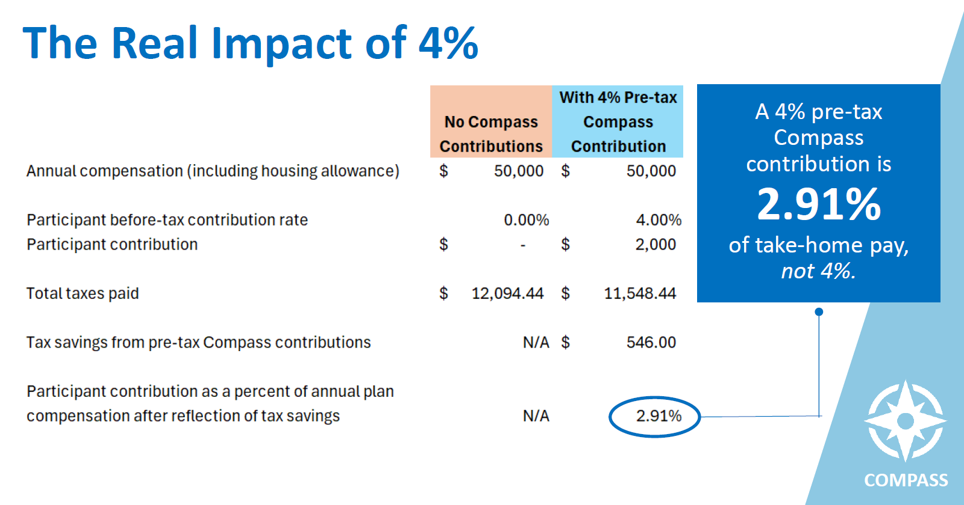

Slide 10

Helping Clergy with
Student Debt
Clergy with student debt often can’t afford 4% personal contribution to receive full match
• Compass will match qualified student loan payments up to 4% of pension-based compensation
• Will settle with Conferences once per year (in Q1 of next year)

Slide 11

**self-certification in Benefits Access portal for student loan payments
-the amount of the loan payment
-the date of the loan payment
-that the employee (clergyperson) made the payment
-that the loan being repaid is a qualified education loan and was used to pay for qualified higher education expenses of the employee, the employee’s spouse, or the employee’s dependent
-that the employee incurred the loan, and not a family member’s loan.

Slide 12



Automatic Features—Helping Clergy
Automatic Features prioritize saving for retirement
Automatic enrollment—so clergy earn full match from employer (4% for 2026)
Automatic escalation—increases savings rate incrementally over time (1% each year up to 8%)
Automatic Investment Program
LifeStage Investment Management
LifeStage Retirement Income program

Slide 13
Auto-enrollment and auto-escalation information:
**No auto enrollment features for more than one bucket of personal contributions
**All Church/employer goes into Compass as pre-tax

Slide 14
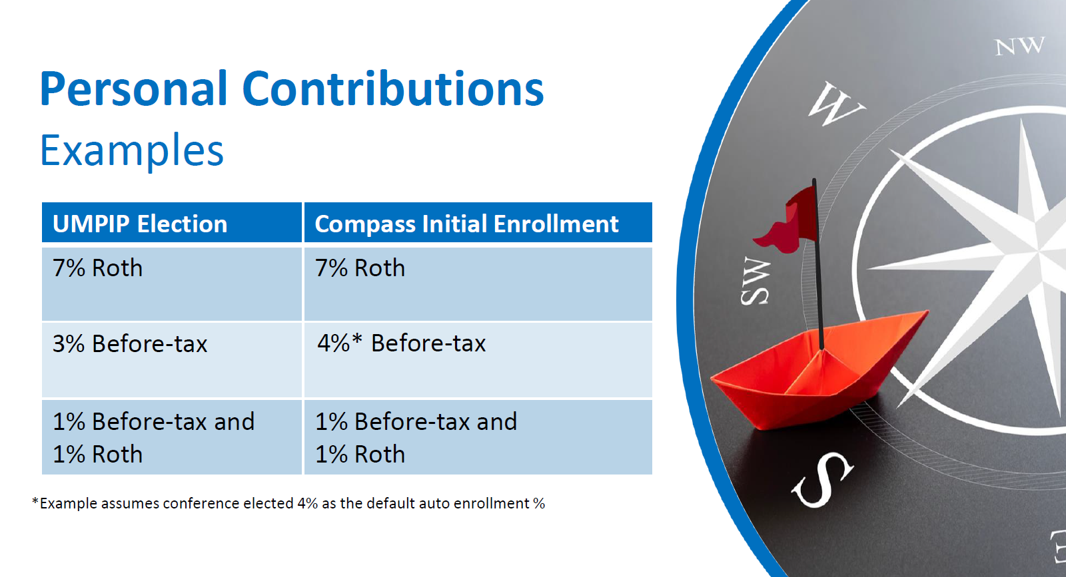

Slide 15
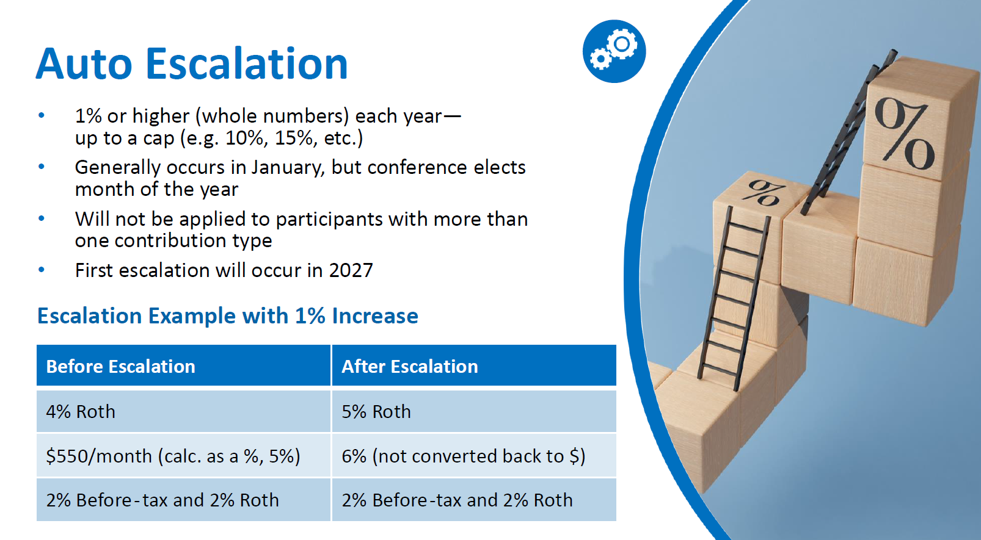

Slide 16
Clergy can change withholdings or opt out of personal contributions at any time prospectively but there may be a lag in implementation based on timing.
75% appointments can opt out of church contributions with a waiver.
*** waiver and enrollment forms are available now

Slide 17
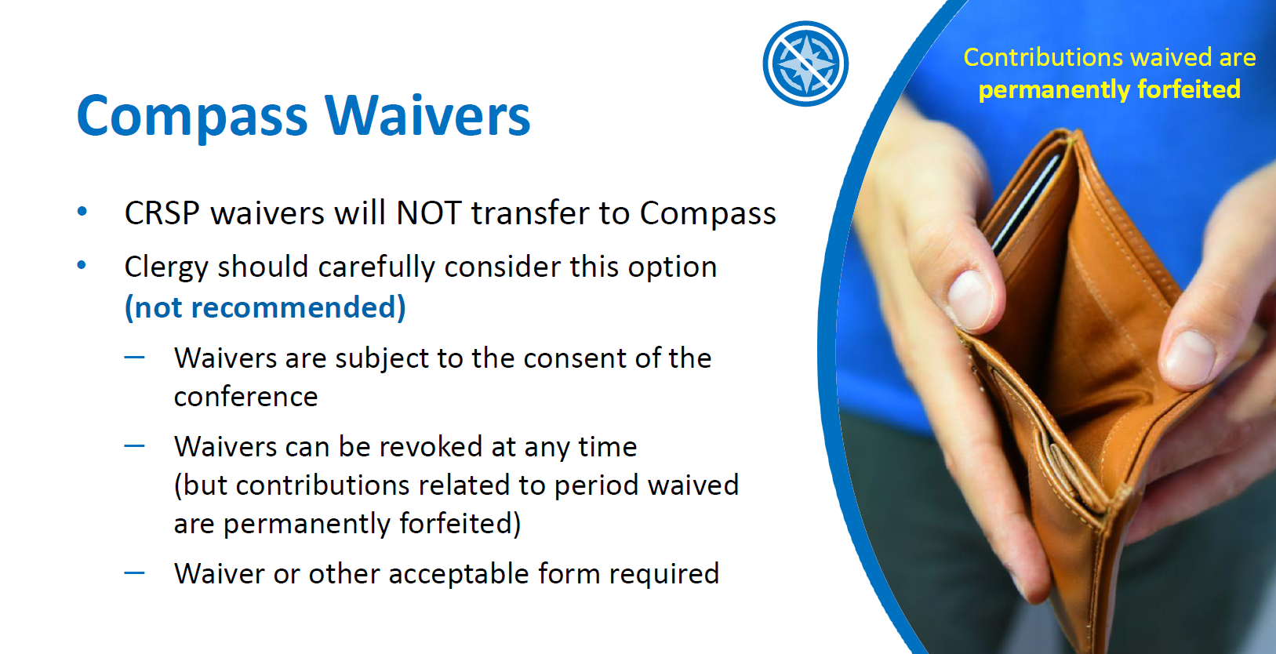

Slide 18

Compass church/employer plan contributions are funded before tax
Compass participant contributions are funded:
Before-tax After-tax
Roth Rollovers

Slide 19
UMPIP Church Retirement Plan for clergy appointed 50 to 74%
-Billed at 9% of the clergy’s pension-based compensation
-Church contributions billed regardless of whether or not the clergy contributes personally
-Clergy can waive out
-Church remains the plan sponsor of personal contributions to UMPIP

Slide 20

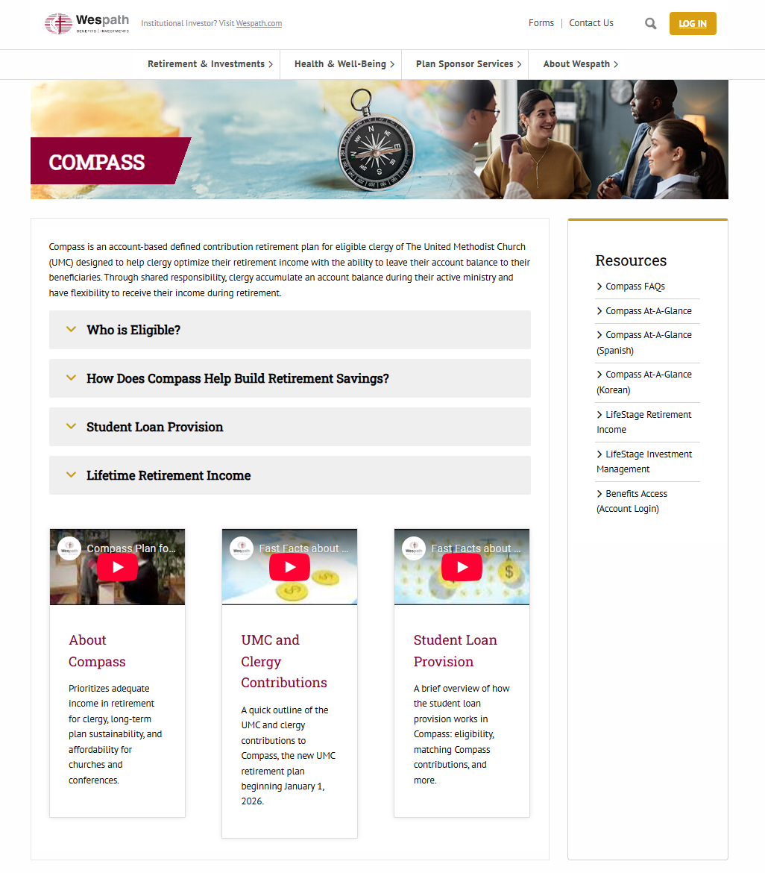

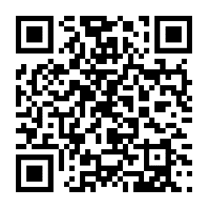
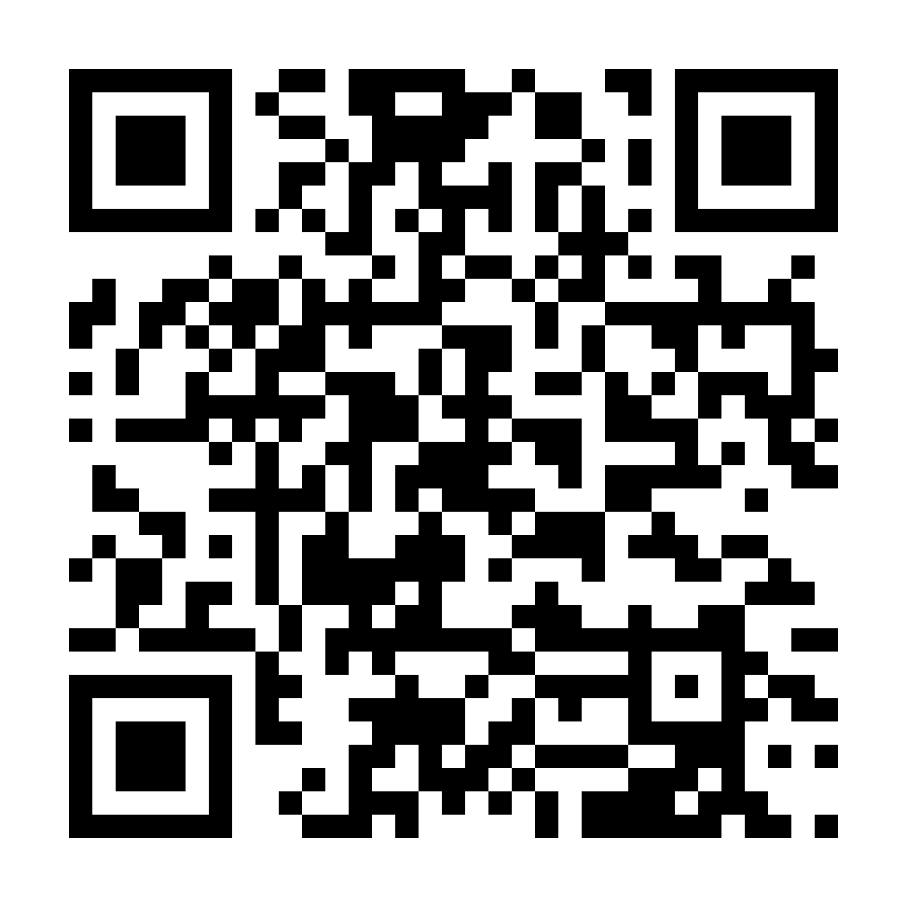
Compass Webpage
wespath.org/r/compass
Home base for
Compass information
Contains ever-expanding resource library
SCAN ME

