Slide 1
UMC Historic Sites
Connected to Upper New York Conference

Slide 2
United Methodist Church historic sites are established by the vote of an Annual, Central, or Jurisdictional Conference in session.
https://gcah.org/resources/becoming-a-historic-site/

Slide 3
UMC’s General Commission on Archives and History (GCAH) has a Traveler’s Guide with details on individual national Heritage Landmarks (https://www.resourceumc.org/en/content/heritage-landmarks-a-travelers-guide), historic information on American Methodism (ex. https://umhistoryhub.teachable.com/), and a Register of regional Historic Sites (https://gcah.org/resources/directories/register-of-united-methodist-historic-sites/).

Slide 4
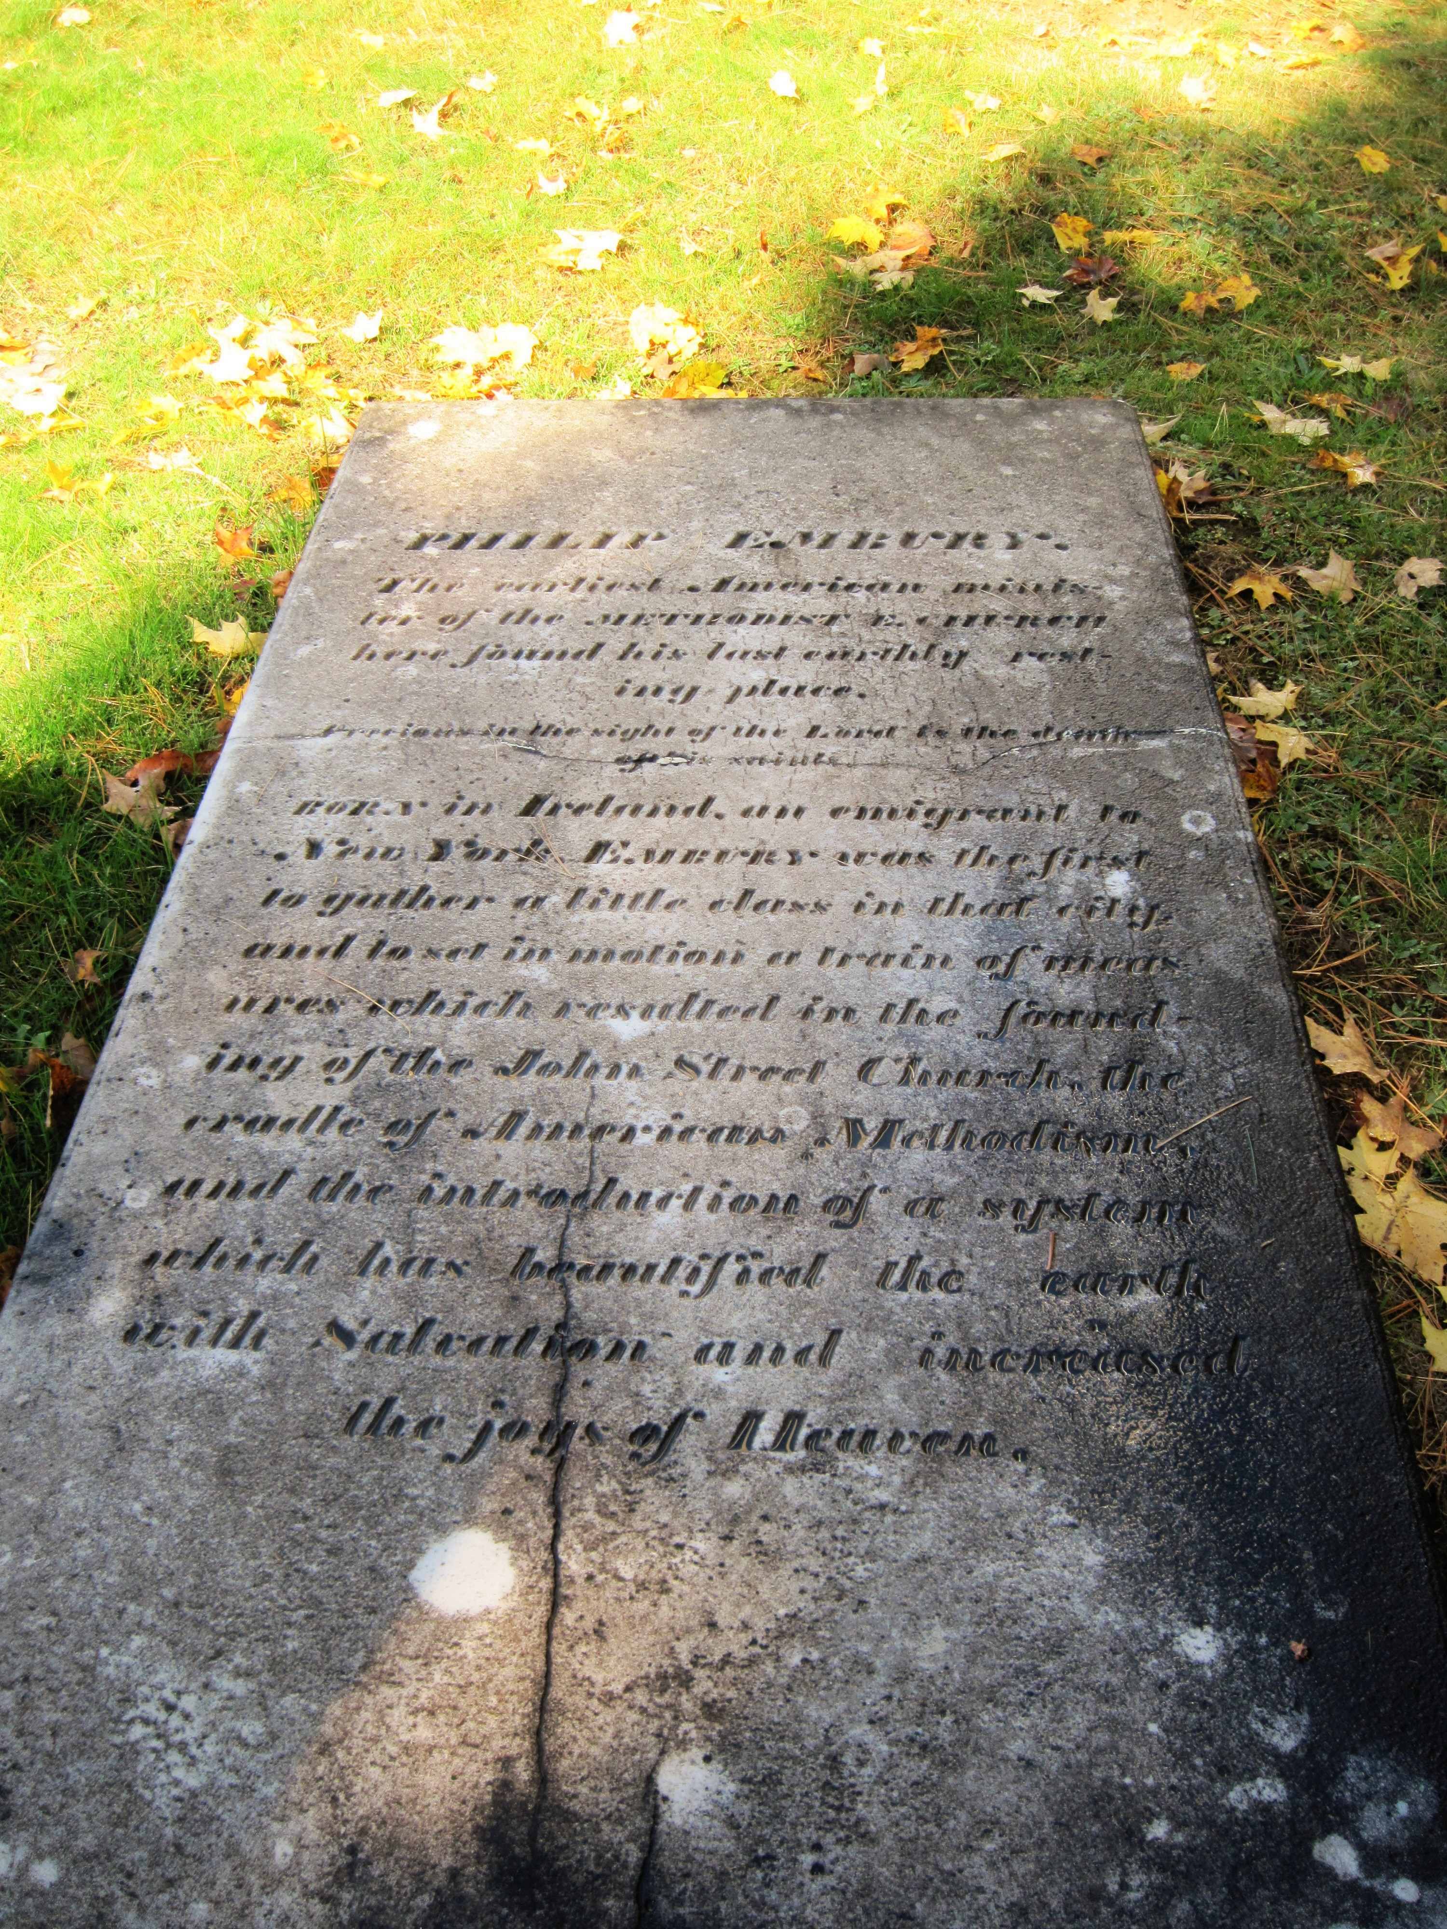
Grave of Philip Embury, Cambridge, NY (251)
Adirondack District
(Washington County)
Philip Embury in Ireland was a local preacher to German Palatines. He “commenced preaching the Gospel of Jesus Christ in the city of New York in the year 1766." A small society was organized by Embury. After two years there were enough to build Wesley Chapel, dedicated in late October 1768 as the first John Street Church.
In 1770 the Emburys & Hecks moved to Ash Grove in Camden Valley in Washington County, NY. Embury organized there with Thomas Ashton the first Methodist society north of New York City.
Philip Embury died 1773. His remains were moved in 1866 to Woodlands Cemetery in Cambridge, NY.

Slide 5
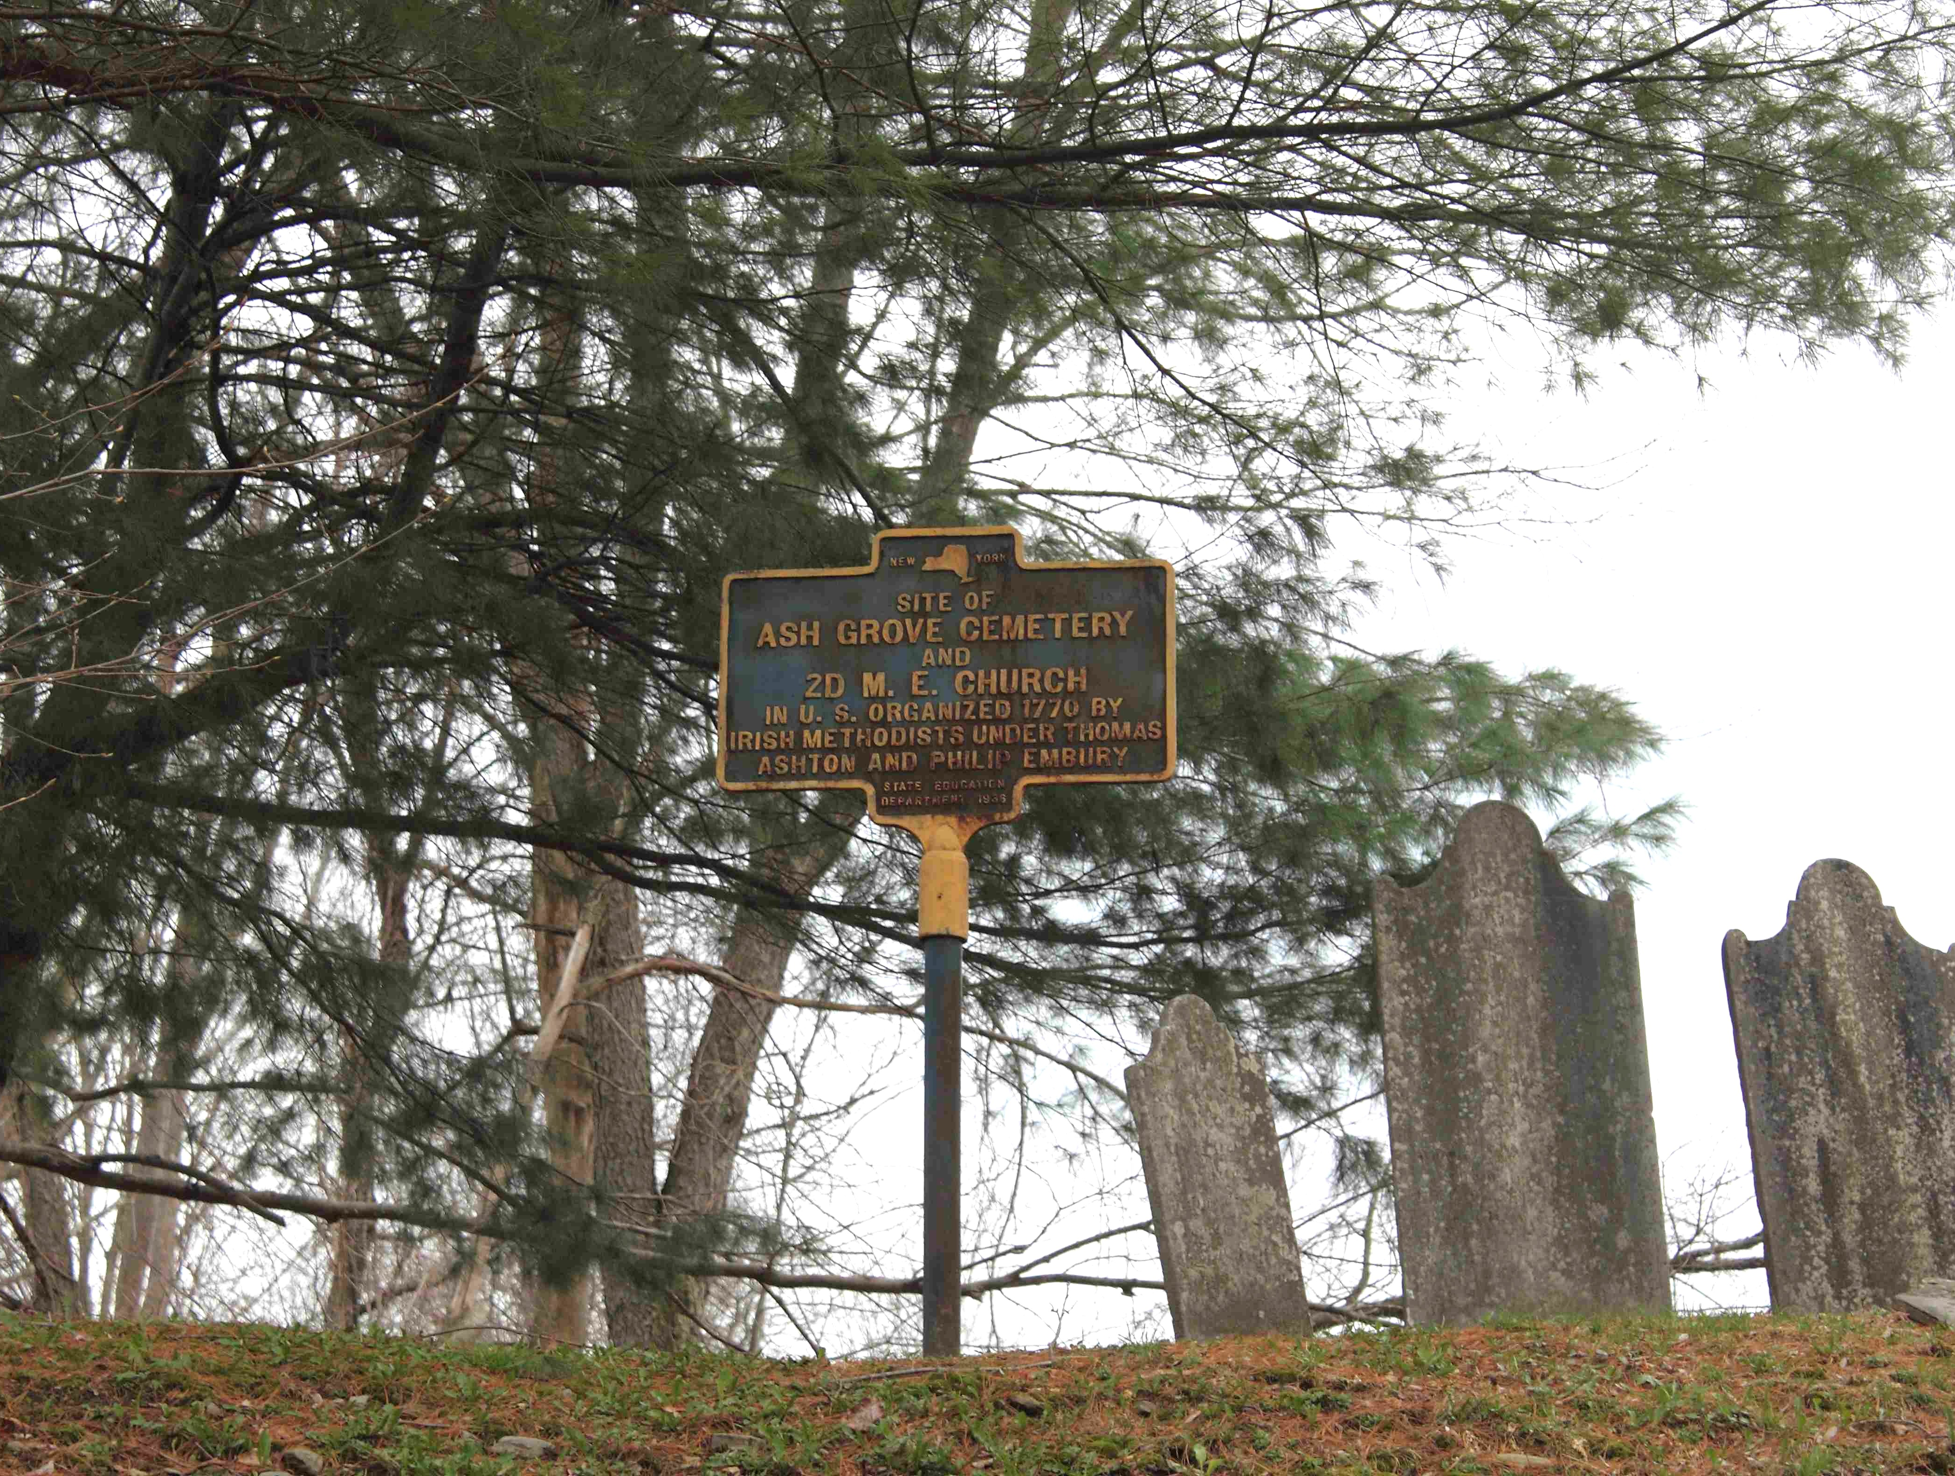
Ashgrove Cemetery, White Creek, New York (252)
Adirondack District
(Washington County)
Philip Embury’s remains were moved in 1832 from the farm where he died to Ashgrove where his church was.
The Ash Grove Cemetery is the site of the 2nd Methodist Episcopal society in the U.S., organized 1770 by Irish Methodists.

Slide 6
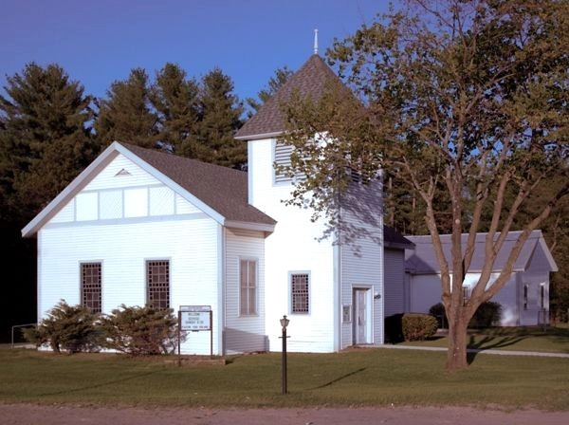
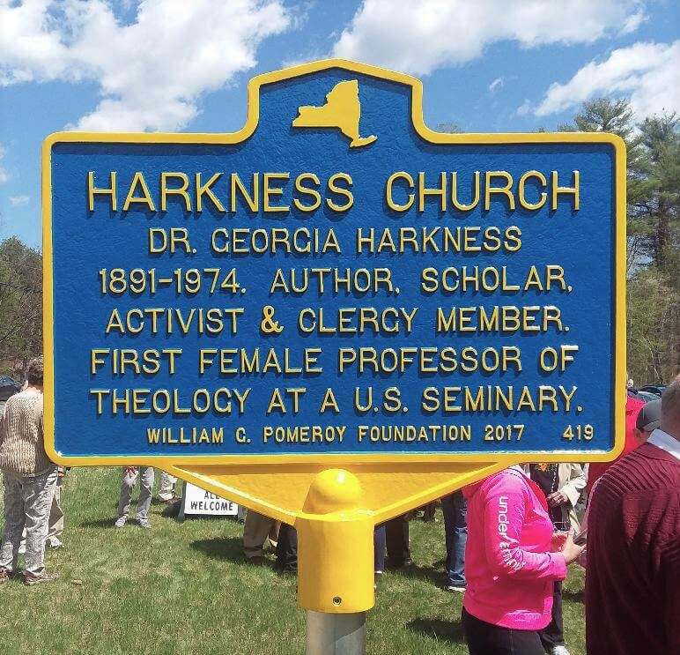
Harkness United Methodist Church, Harkness, NY (p.o. Peru) (582)
Adirondack District (Clinton County) – home church of Dr. Georgia Harkness it became an UMC historic site in 2025

Slide 7
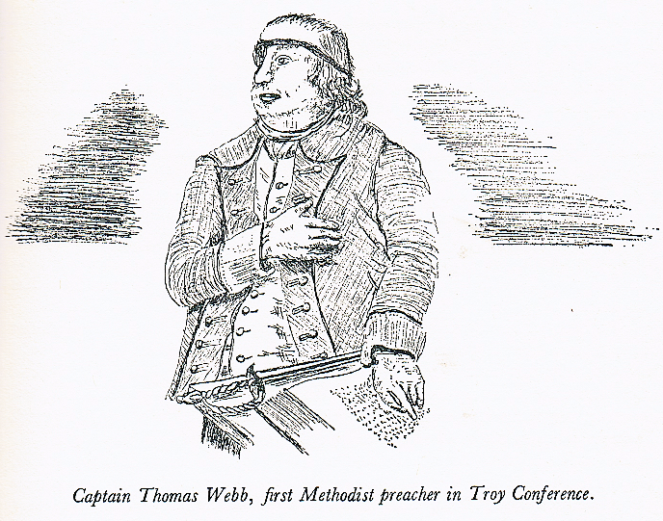
Grave of Captain Thomas Webb,
Wesley Chapel, Bristol, England (19)
Albany District (Albany County) & beyond
When Captain Thomas Webb was a Barrack Master 1765-66 in Albany, NY, he is believed to have been the first Methodist preacher in the area of Troy Conference.
Capt. Webb met Philip Embury (251) when he preached at John Street’s Wesley Chapel in New York City.
Ultimately, Webb preached along the Atlantic seaboard & helped establish several Methodist societies.

Slide 8
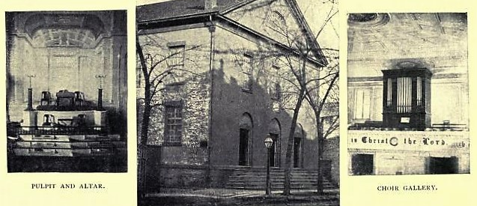
Property of Christ U.M. Church, Troy, NY (296)
Albany District (Rensselaer County) - In late 1808 the State Street Methodist Episcopal Church of the village of Troy was incorporated with a meeting house completed in 1811. A brick church (above - https://archive.org/details/historyofmethodi00hilliala/page/50/mode/2up) was built in 1827 and a blue limestone church in 1871.

Slide 9
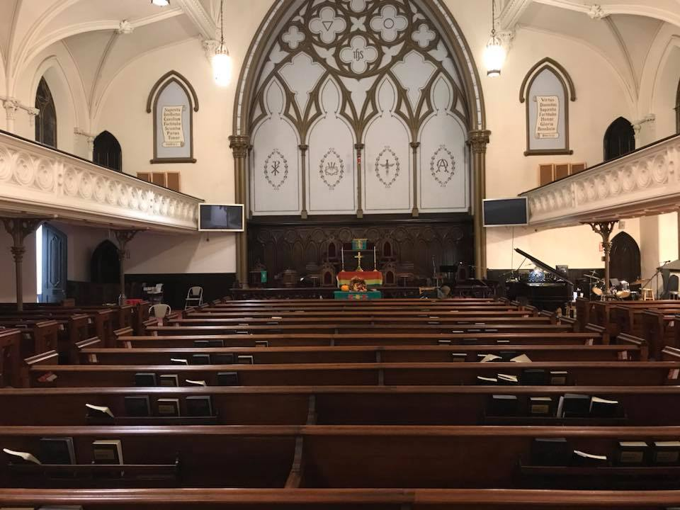
Property of
Christ U.M. Church, Troy, NY (continued)
Mergers: State Street M.E. Church merged with the Third Street Methodist Episcopal Church in 1879. In 1925 State Street M.E., Fifth Avenue M.E., and the German Methodist Episcopal Church merged under the name Fifth Avenue-State Street Methodist Episcopal Church. In 1965 that church and Trinity Methodist Church merged to form Christ Church (in the 1871 church bldg.).
A chapel was constructed at the 35 State Street at 5th Ave. church with “holy relics” from Trinity Methodist Church.

Slide 10
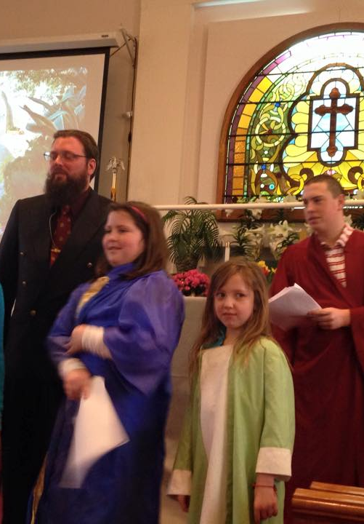
Sauquoit Valley U.M. Church, Sauquoit, NY (411)
Mohawk District (Oneida County)
In 1801, a deed conveyed one acre to the Methodist Episcopal Church, and the church was built at a cost of $950. The present brick church (which includes the cornerstone from the old church) replaced the original wood frame one in 1842.
A burying ground originally occupied the church yard but was moved about one-half mile eastward. The old church was moved next door and used as the Sauquoit Academy.
In 1995 the Sauquoit church was renamed the Sauquoit Valley United Methodist Church when it merged with the Willowvale United Methodist Church in Chadwicks, NY.

Slide 11
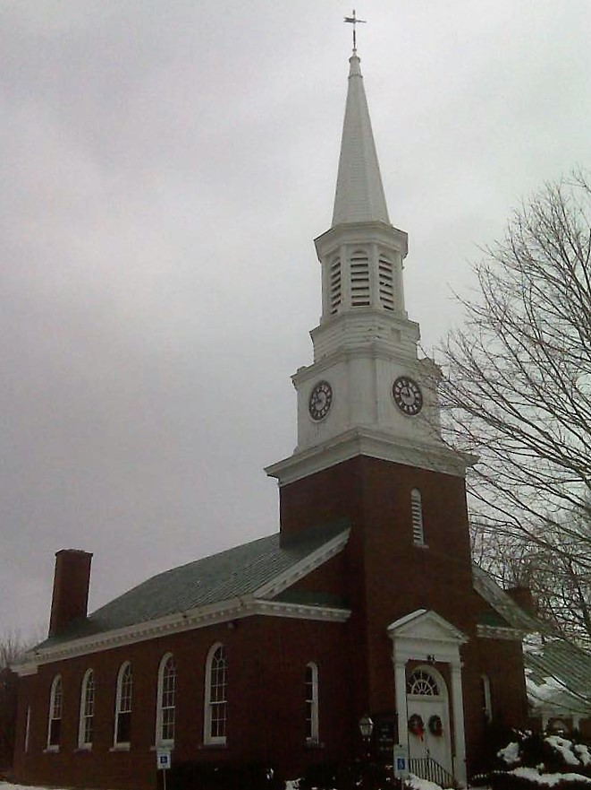
Woolworth Memorial U.M. Church, Great Bend, NY (424)
Northern Flow District (Jefferson County)
This church, as noted by Woolworth Memorial in its title, was a gift to the village in 1915 from Frank W. Woolworth of five and ten cent fame in memory of his parents. It was the third building to house the First Methodist Society of the Town of Champion formed in 1825 (after 1826 & 1887 buildings).
A Heritage Room in the church holds objects from the first “Old Church.”
Details on the first two buildings are at: https://www.4rvhs.org/woolchur.html.

Slide 12
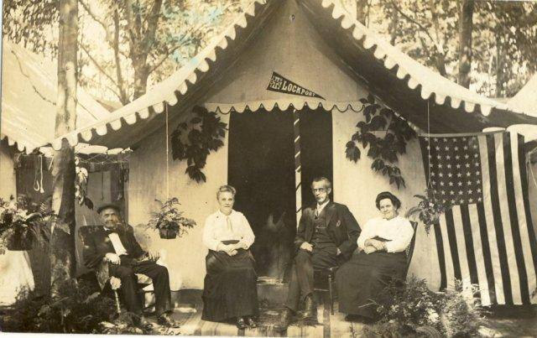
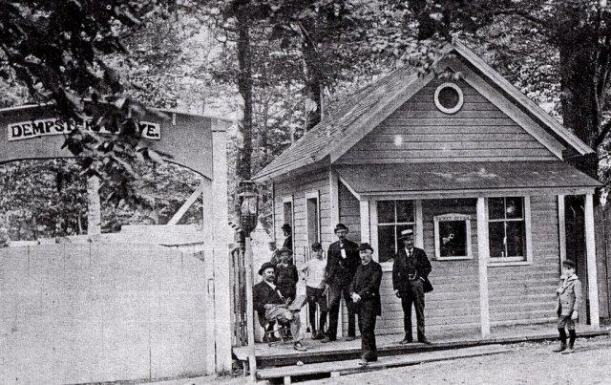
Dempster Grove Camp, New Haven, NY
(401) Crossroads District (Oswego County) – established 1875 as a Christian campground near Lake Ontario; named “Dempster Grove” for John Dempster, a well-known Methodist minister - Over 100 tents were erected and there were two gates, one for horses and buggies and another for buses from the trains. The first Sunday 3,500 attended. Cottages were erected the following year. In 1902 the Tabernacle was completed and dedicated and in 1908 the “Lady’s Improvement Society” organized to upkeep the buildings, buy supplies, etc.

Slide 13
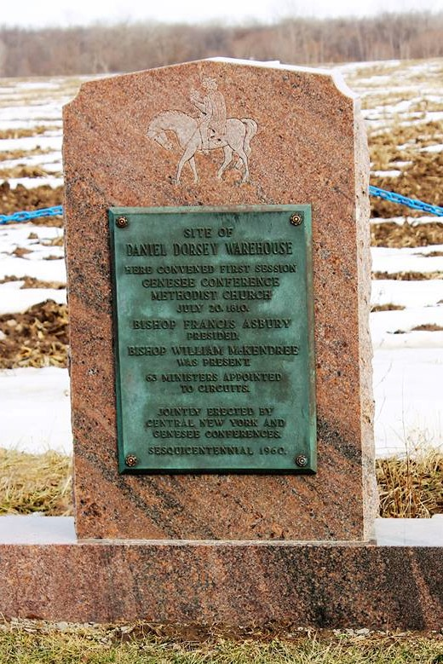
First Session of Genesee Conference, Lyons U. M. Church, Lyons, NY (109)
Finger Lakes District (Wayne County)
“Journal of the Genesee Conference, which met in session at Captain Dorsey’s, Lyon’s Town, State of New York, July 20, one thousand eight hundred and ten [1810]. At which Francis Asbury and William M’Kendree presided. A majority of members being present, William M’Kendree took the chair and proceeded to business.”
The record of the first session notes that the Genesee Conference was composed of the Susquehanna, Cayuga, Upper and Lower Canada districts and was formed from New York Conference (Cayuga District and part of Canada) and the Susquehanna District of Philadelphia Conference.

Slide 14
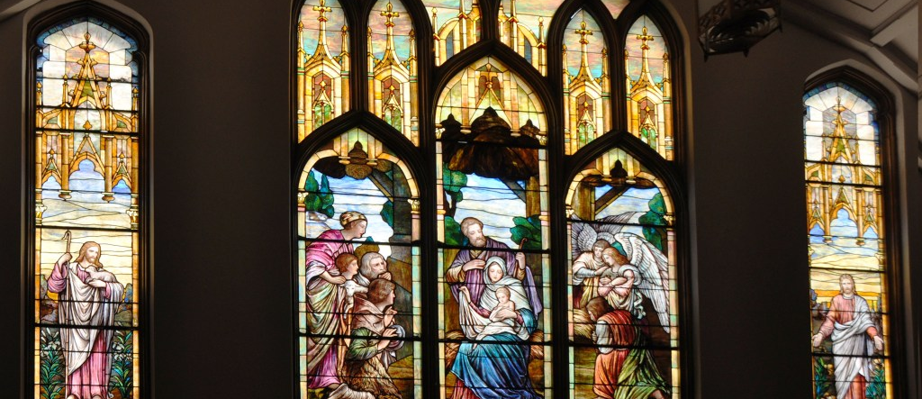
First U.M. Church, Newark, NY (410)
Finger Lakes District (Wayne County) - The congregation formed in 1805. Circuit rider Roger Benton settled in Newark in 1806 (when Lyons circuit [109] was formed). In 1815 the first M.E. church in town was erected on his farm where the cemetery is now. After twelve years, a second building was erected near the center of the village in 1827. A new church was built in 1856 and remodeled in 1888, 1915, & 1923 when seven stained glass windows and a 75-foot bell tower were added.

Slide 15
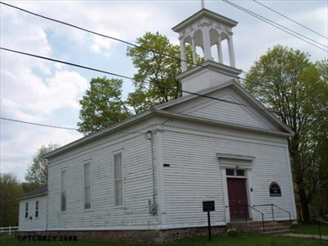
Butler Center M.E. Church, Butler Center, NY (402)
Finger Lakes District (Wayne County)
The former Methodist Episcopal Church of Butler is the oldest Methodist Episcopal Church building in Wayne County built in 1836 from trees cut on site and milled at a local sawmill. Some Italianate style detailing was added in the 1860s.
The church had regular services until 1968 and then two services a year until the 1980s. It retains the original paneled lectern and other early design features such as outlines of the original pew boxes on the floor and was listed in 1997 on the National Register of Historic Places. It is now a museum.

Slide 16
History is not a burden on the memory but an illumination of the soul.
- Lord Acton
There are other historic places in Upper New York Conference which are special to Methodism. While these may be considered historic, they have not gone through the process - by action of the conference where sited - to be made regional United Methodist Historic Sites.
For information on the UMC process, visit https://gcah.org/resources/becoming-a-historic‑site.

