Slide 1
Compass: Church Information

Slide 2
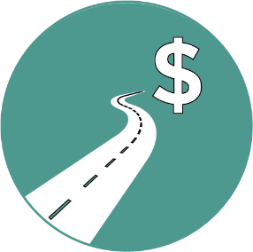


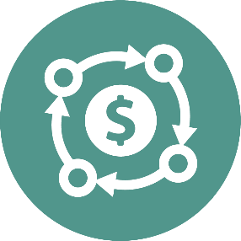
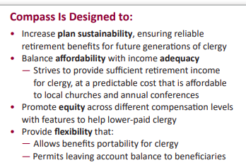
Why Compass?
Sustainability
Affordability
Adequacy
Flexibility

Slide 3
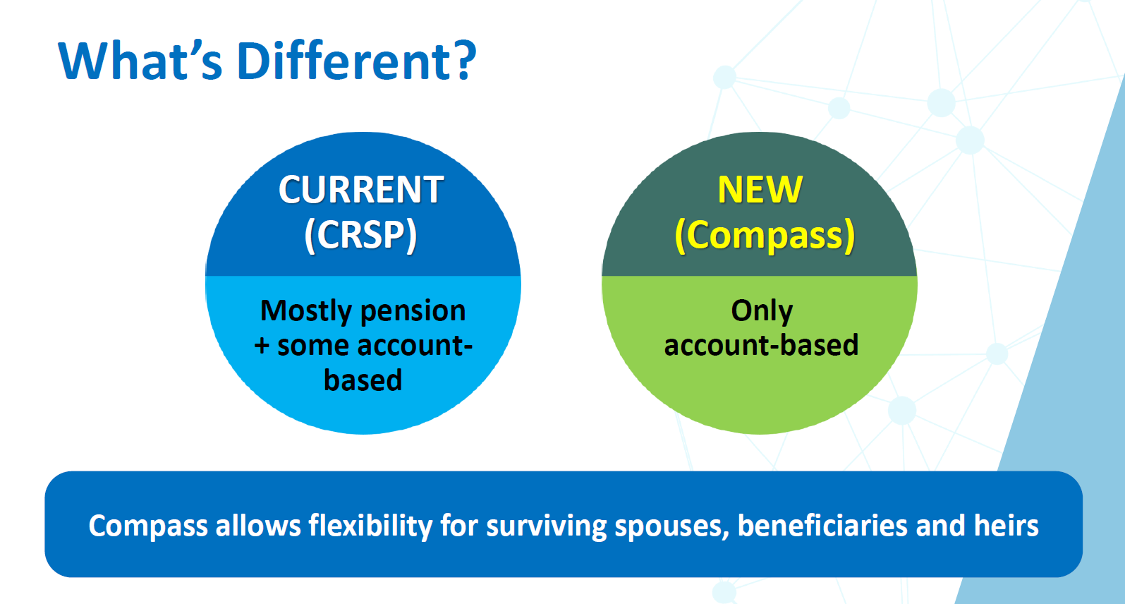

Slide 4





UMC Retirement Contributions (effective January 1, 2026)
Automatic contributions
In partnership with clergy
$1/$1 matching contribution
(up to 4% of compensation)
$150* per month
+
3% of compensation**
+
* 2026 amount; increases 2% per year ($5 increments)/prorated by appointment percentage (will not go up until 2028)
** Compensation includes 35% parsonage value ($10,000 minimum floor) or housing allowance

Slide 5


Compensation Highlights
Parsonage
35% of Annual Base Wages
Minimum of $10,000
Not prorated if less than full time appointment
A parsonage will be applicable across ALL churches in the appointment
The parsonage value is just for the purpose of retirement plan contributions, NOT taxes (real rental value is used for tax purposes)
Excludes
Severance Pay
One time or occasional payments (i.e., bonus or expense reimbursements)

Slide 6
Billing to local churches: The CBOPHB has voted to bill all churches with eligible clergy for Compass (unless waived) at 10.5% of pension-based compensation regardless of personal contribution amounts. (This is 3.3% less than current CRSP billings of 13.8%) ***UNY is the plan sponsor for Compass personal contributions starting 1/1/2026 Why??: 1. Simplicity 2. Arrearages 3. Retro matching contributions

Slide 7
Church Billing for Compass
Churches with Compass eligible clergy will see a billing line with their pastor’s name,
Compass ID text and the monthly amount under the “Benefits Paid From Chuirch Budget” heading.
Churches with eligible clergy will see a billing with their pastor’s name, Compass contribution type and the monthly amount under the “Benefits Paid By payroll Deduction” heading for applicable personal contributions.

Slide 9

Helping Clergy with Student Debt Clergy with student debt often can’t afford 4% personal contribution to receive full match • Compass will match qualified student loan payments up to 4% of pension-based compensation • Will settle with Conferences once per year (in Q1 of next year)

Slide 10
Special Features Automatic Enrollment (4%) and Escalation (yearly on 1/1 up to 8%) **No auto enrollment features for more than one bucket of personal contributions **All Church/employer goes into Compass as pre-tax

Slide 11
Clergy can change withholdings or opt out of personal contributions at any time prospectively but there may be a lag in implementation based on timing. 75% appointments can opt out of church contributions with a waiver. *** waiver and enrollment forms are available now upon request from clergy person

Slide 12

Compass church/employer plan contributions are funded before tax Compass participant contributions are funded: Before-tax After-tax Roth Rollovers

Slide 13
UMPIP Church Retirement Plan for clergy appointed 50 to 74% -Billed at 9% of the clergy’s pension-based compensation -Church contributions billed regardless of whether or not the clergy contributes personally -Clergy can waive out -Church remains the plan sponsor of personal contributions to UMPIP

