Slide 1
Clergy Withholding Elections and Communication

Slide 2
Full-Time Benefits Eligible
Clergy Elections-to be withheld on a pre-tax basis from the pastor’s paycheck
Health insurance personal contributions (elected by pastor year to year during Annual Election in November for the following year coverage). Shown as PERS HlthFlex Contr on the church billing statement.
Health account contributions (must be elected by the pastor every year during Annual Election in November for the following year coverage). Shown as FSA, DCA or HSA on the church billing statement.

Slide 3
All clergy appointed to Local Church
or Conference Eligible
Personal contributions to retirement accounts (can be
elected/changed/stopped at any time during the year, on the first of a month and
cannot be retroactive)
The United Methodist Personal Investment Plan (UMPIP) is a 403(b) plan, subject to
contribution limits under the Internal Revenue Code-limits based on age
Contributions can be made one of three ways:
Before-tax, Roth (after-tax) and After-tax
Treasurer fills and signs as Plan Sponsor/Salary-paying unit
Billed directly to church and remitted directly to Wespath

Slide 4
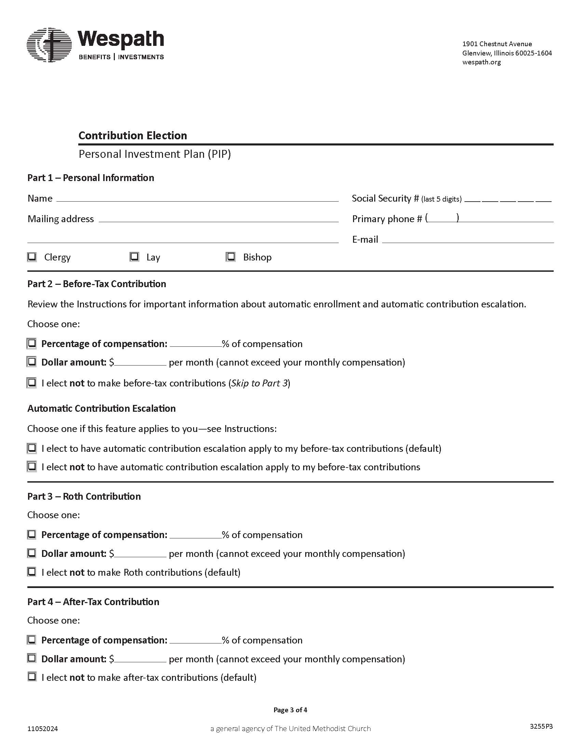

Slide 5
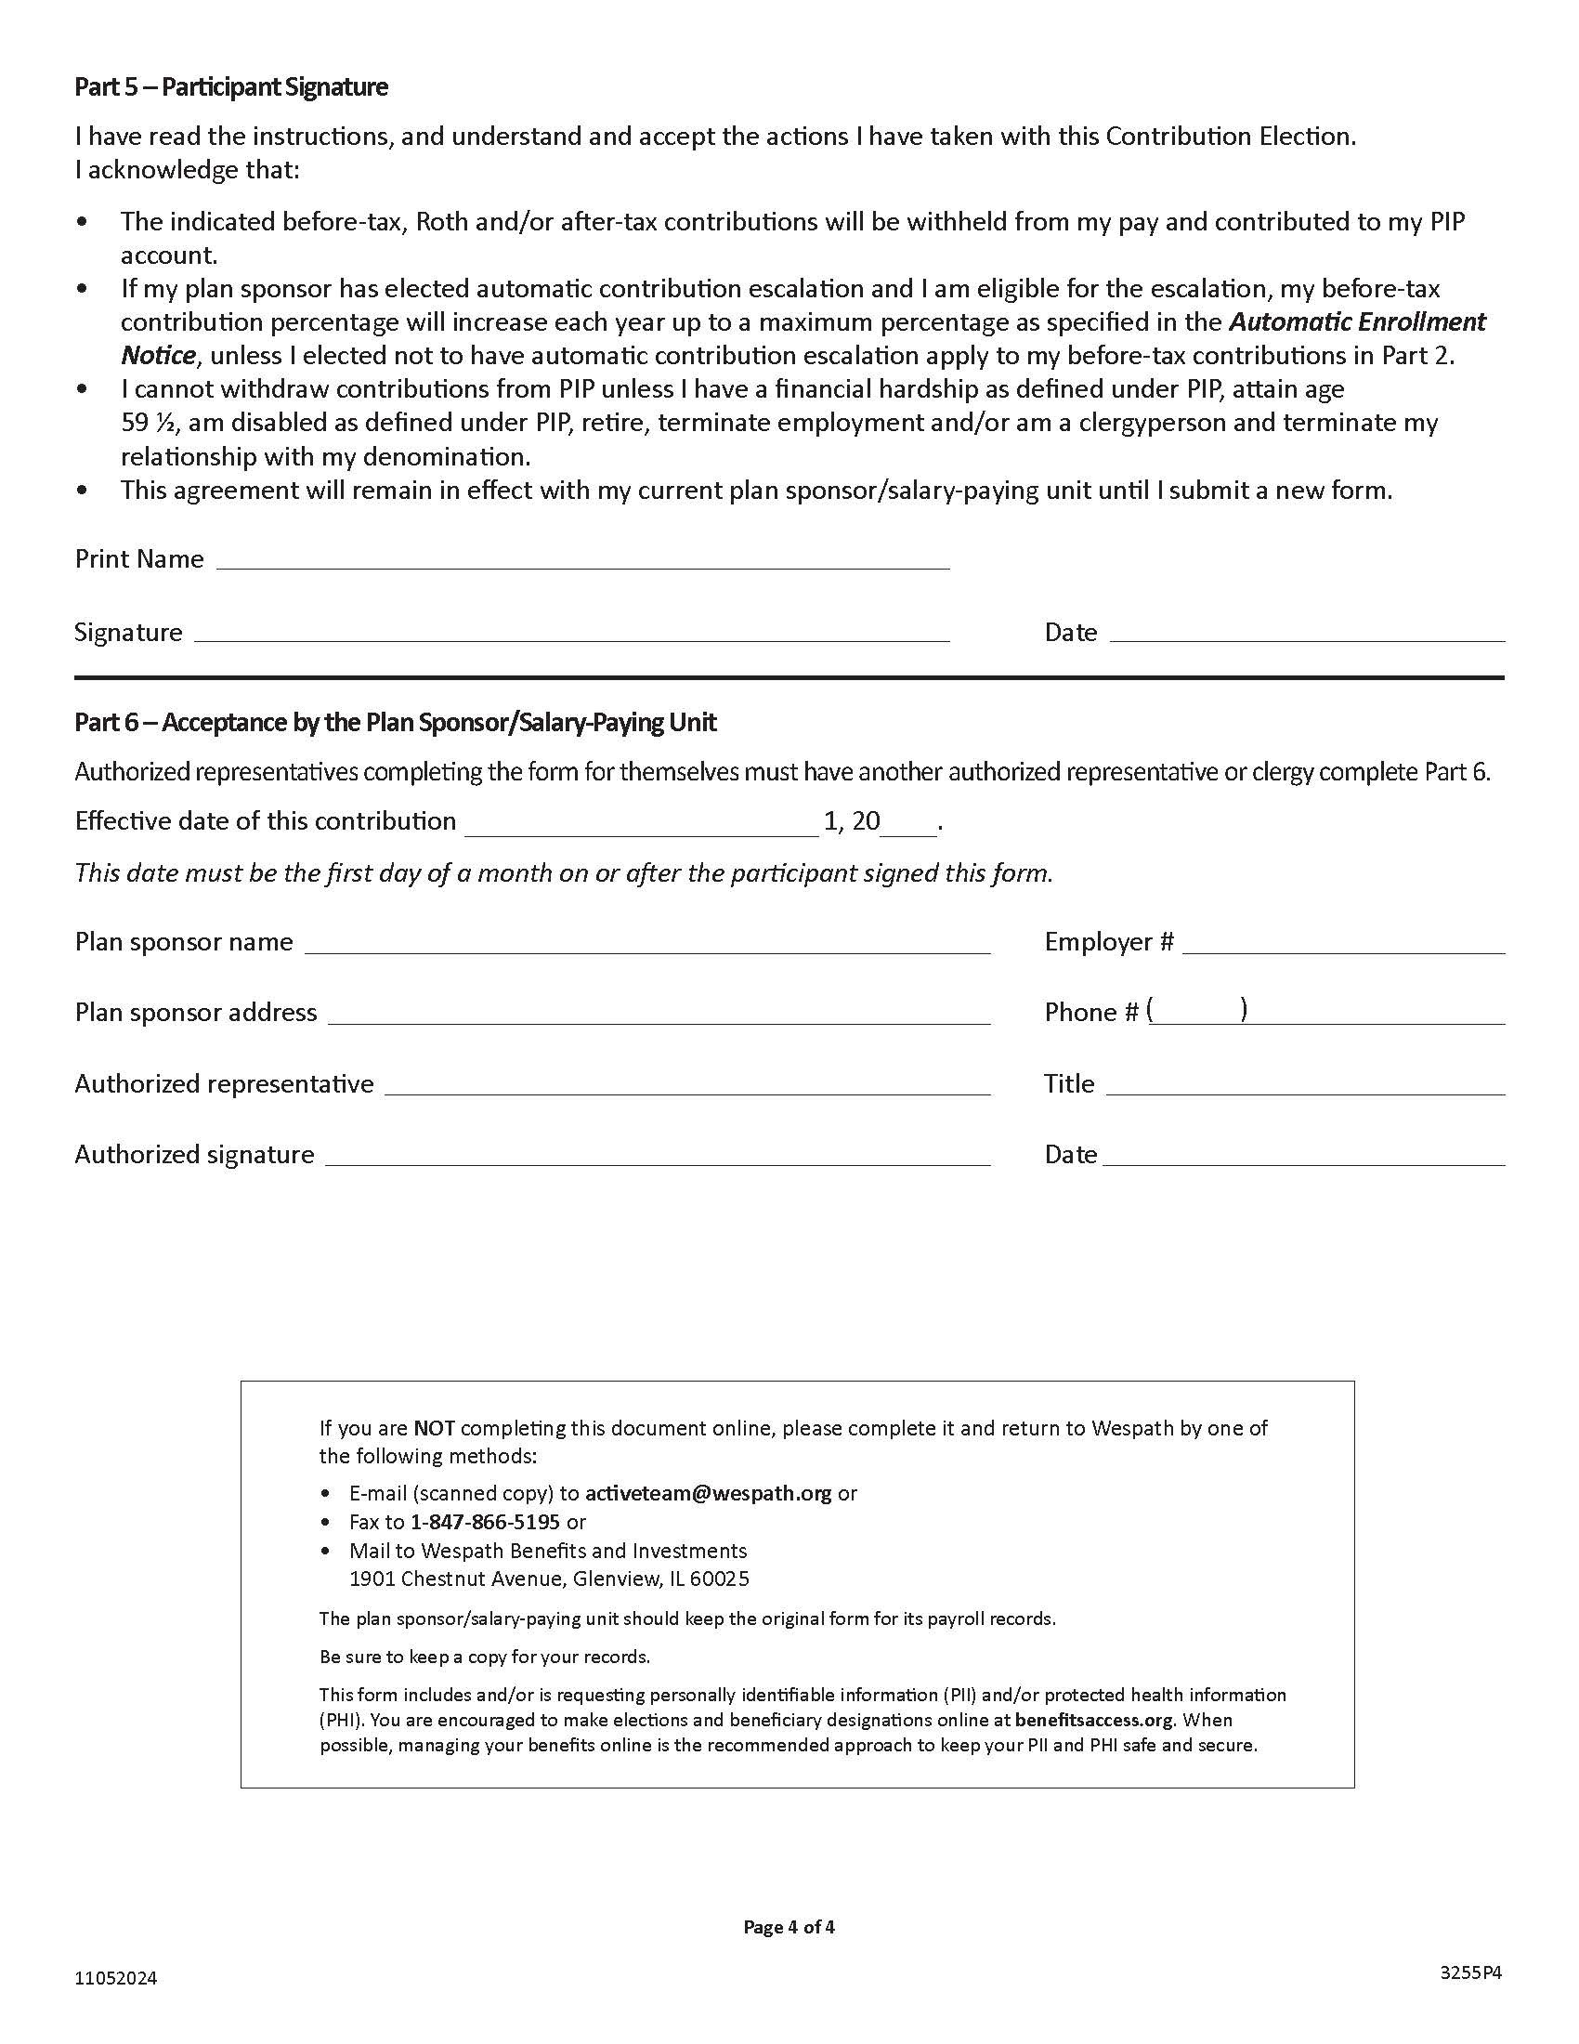

Slide 6
Communication
All elections should be communicated by the pastor to the appropriate payroll person (church treasurer, finance chair, etc.)
Clergy will know their appropriate health related elections and withholding amounts during their annual election in November

